Slide 1



Installing Anaconda
A guide for Windows, Mac and Linux
Notes:
First, Anaconda. Anaconda is a powerful toolkit for data science and machine learning. "Anaconda is a free, open-source distribution for Python. It includes tools like Jupyter Notebook, Spyder, and over 1,500 data science packages, making it a one-stop platform for data analysis and machine learning
making it easy to start working without worrying about installing everything separately.
Next, libraries. Libraries are pre-written code that help us perform specific tasks, like analyzing data with Pandas, building machine learning models with Scikit-learn, or creating visualizations with Matplotlib. They save us from writing complex code from scratch.
Finally, environments. Think of environments as isolated workspaces where you can install libraries and manage dependencies for specific projects. They let you work on multiple projects without conflicts between different library versions.
Together, Anaconda, libraries, and environments streamline the workflow for data science and programming, ensuring everything is efficient and organized."

Slide 2


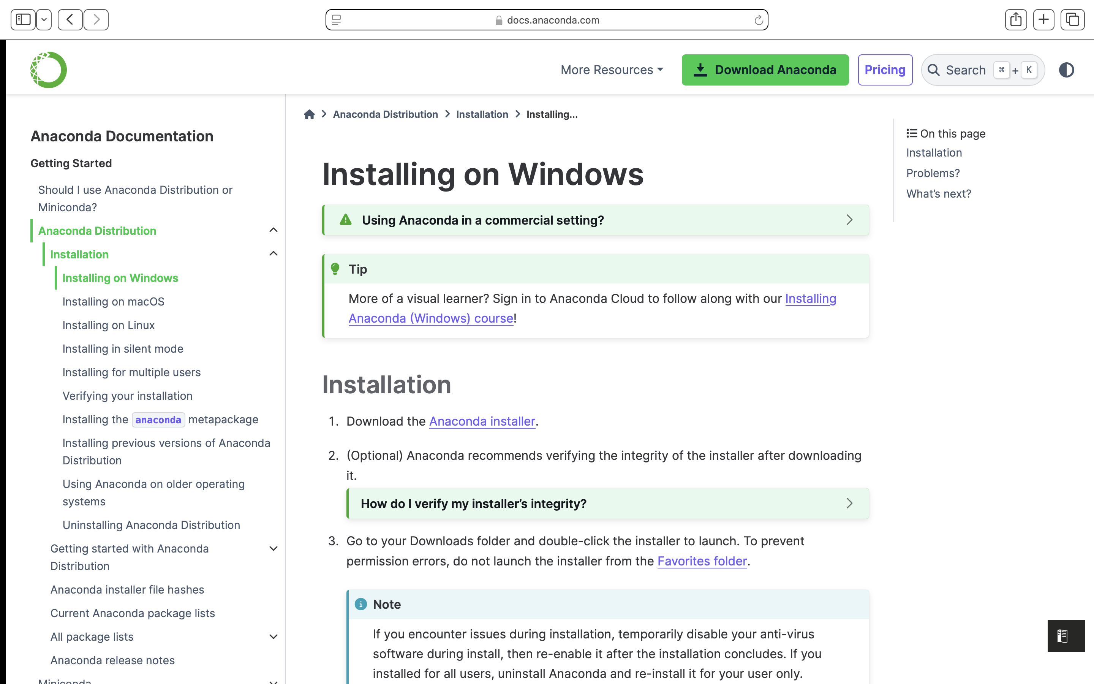
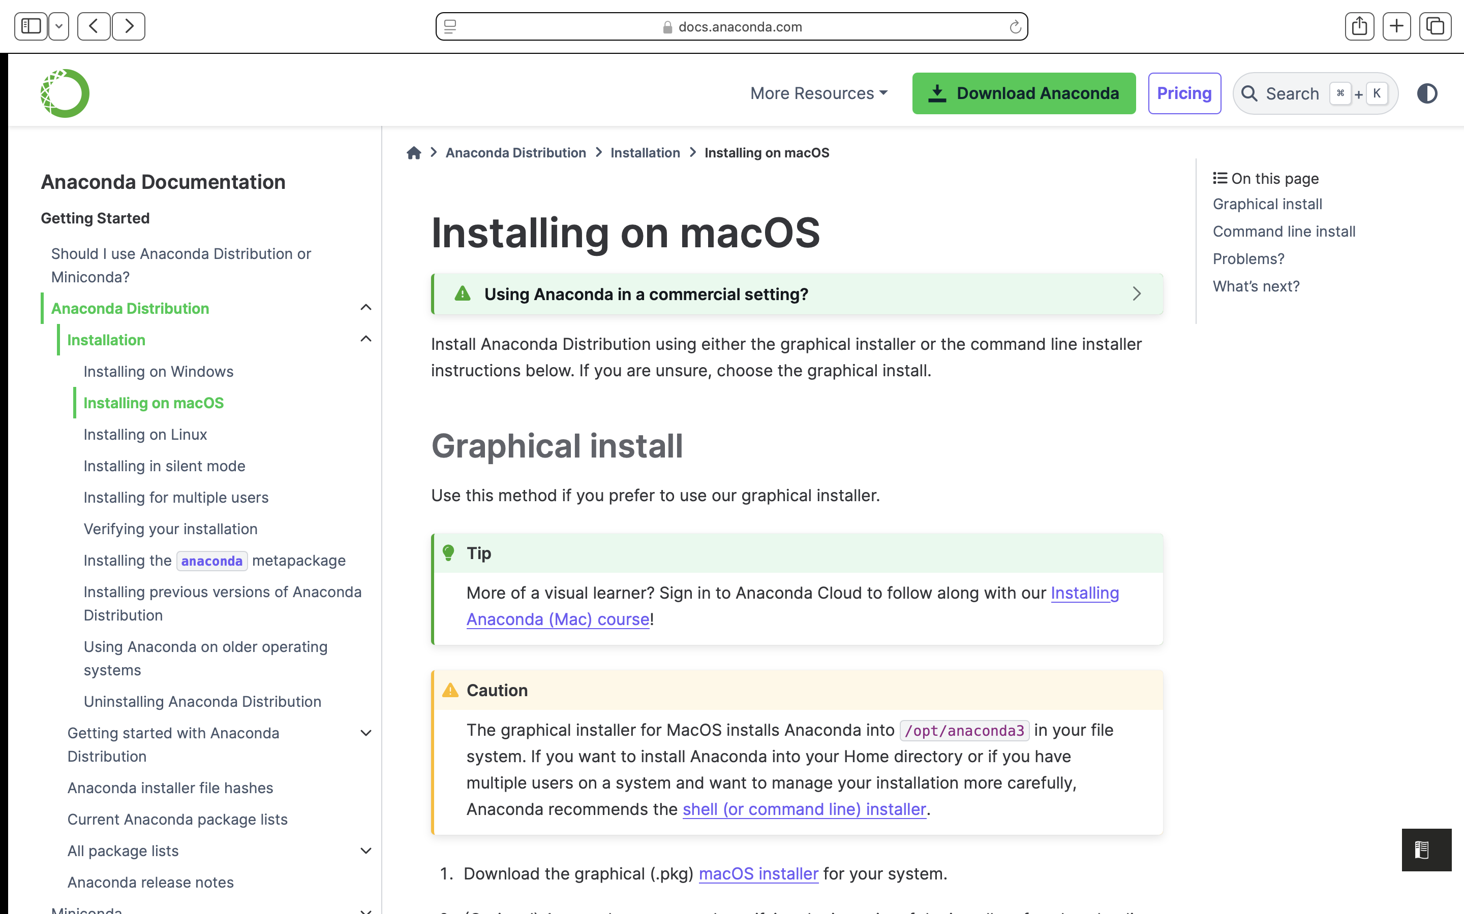
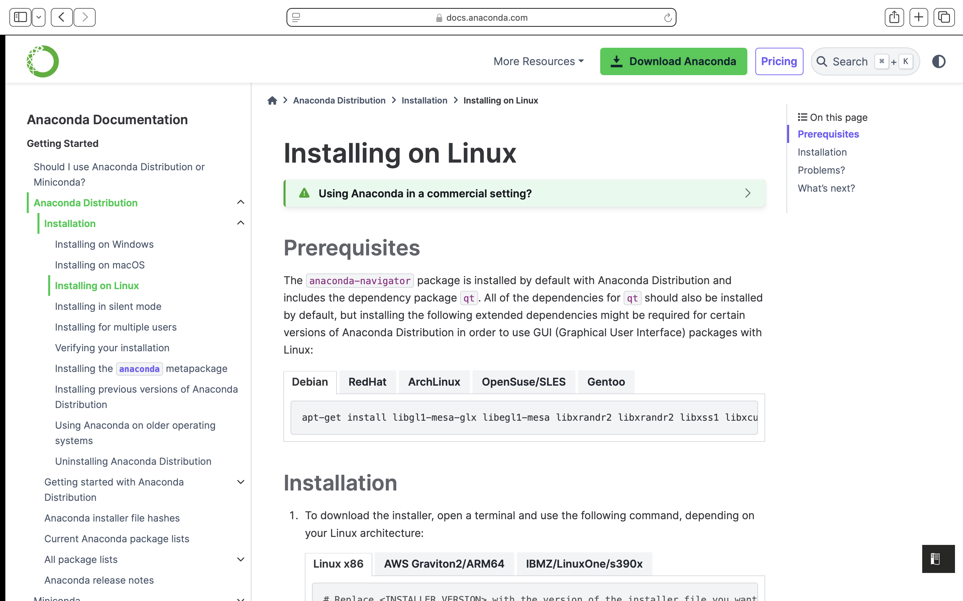
Installation Guides
MacOS – https://docs.anaconda.com/anaconda/install/mac-os/
Windows – https://docs.anaconda.com/anaconda/install/windows/
Linux – https://docs.anaconda.com/anaconda/install/linux/

Slide 3
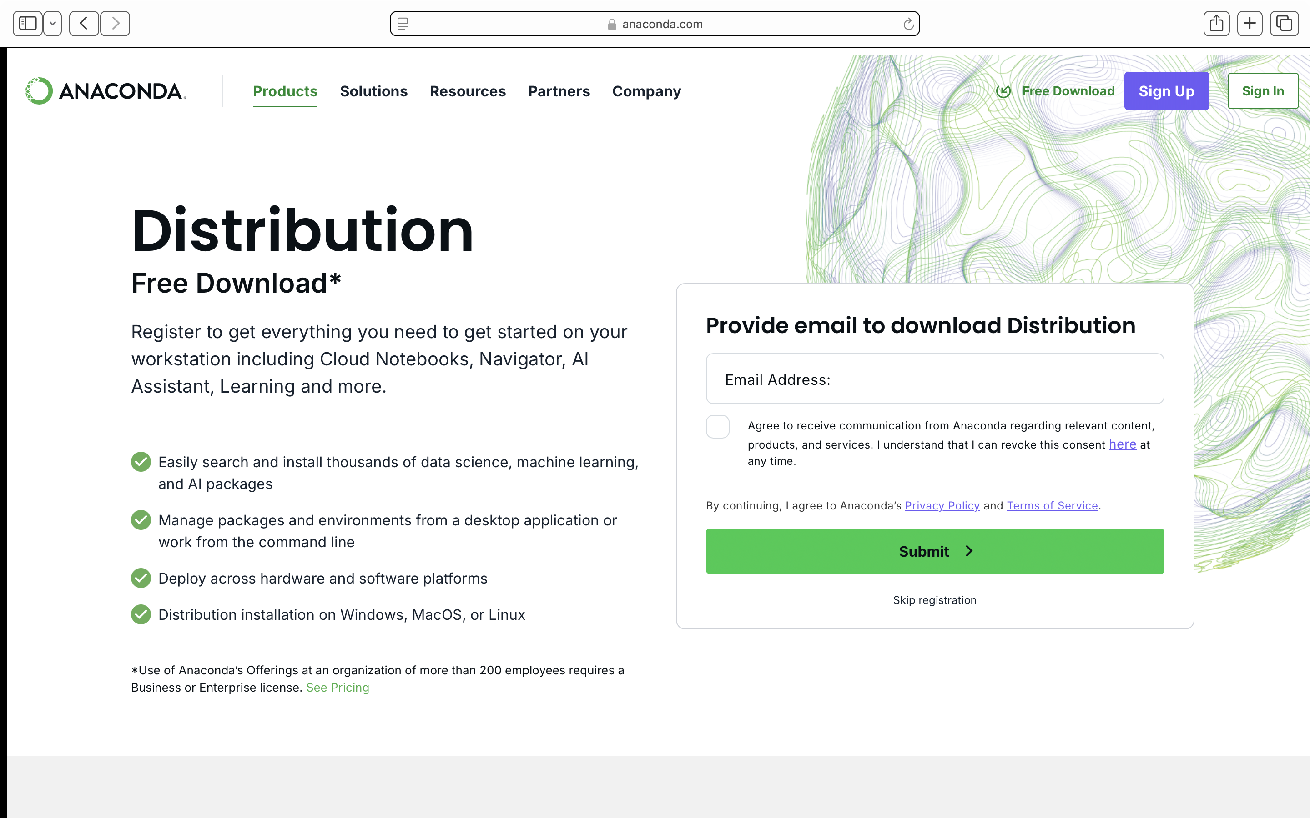
Download Anaconda

Slide 4
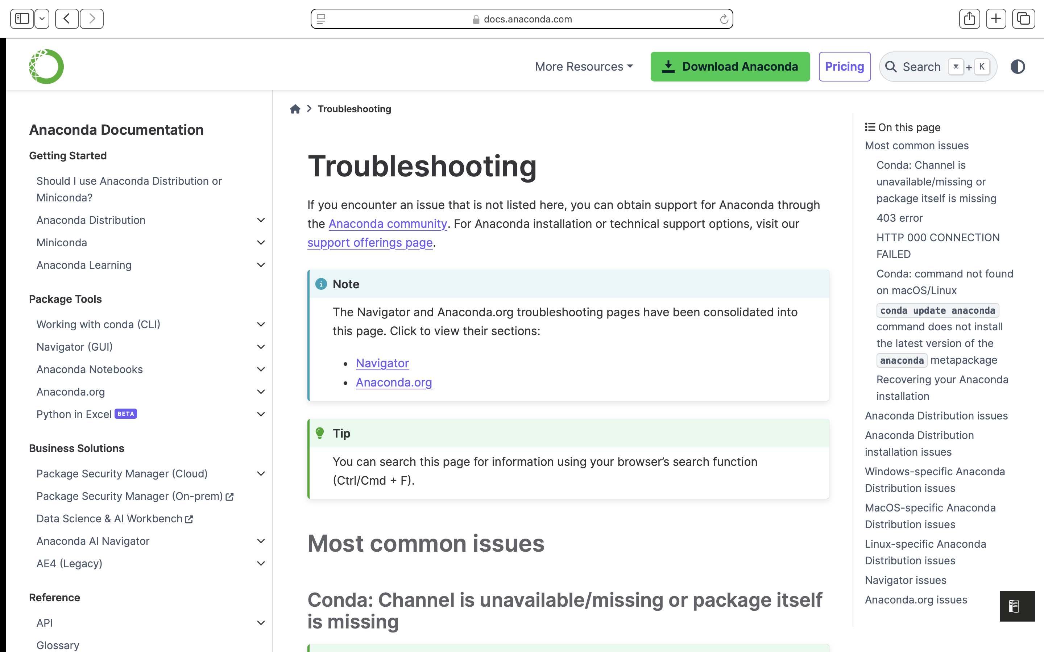
Troubleshooting
https://docs.anaconda.com/reference/troubleshooting/

Slide 5
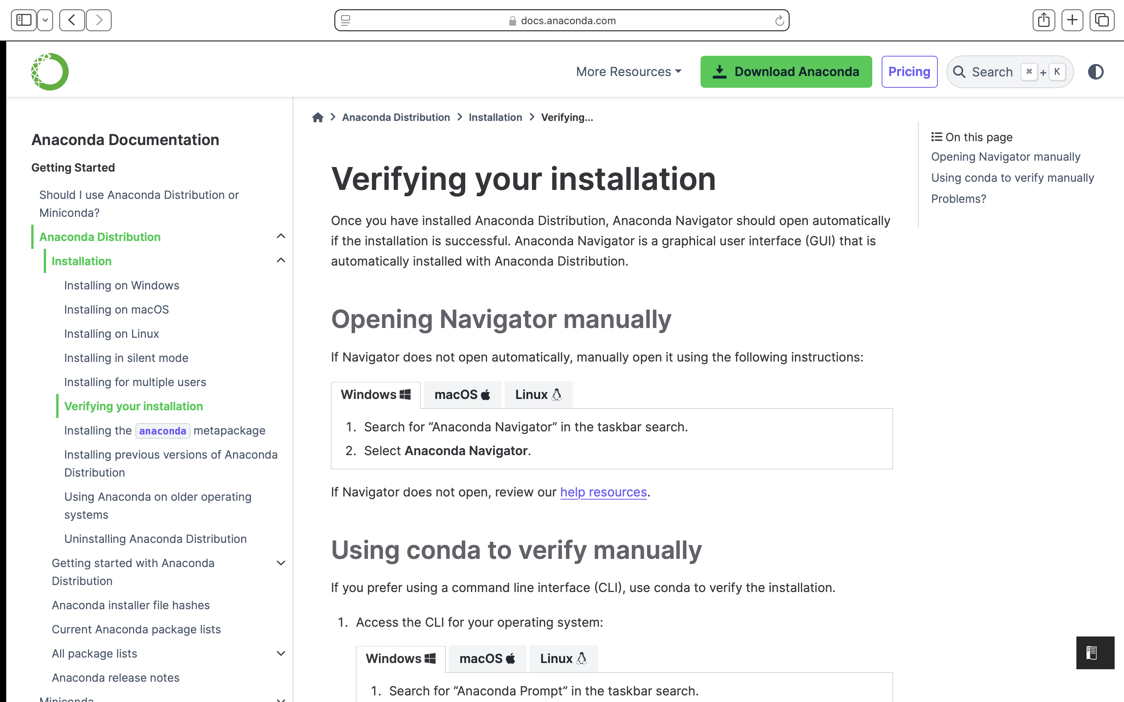
Verifying your installation
https://docs.anaconda.com/anaconda/install/verify-install/

Slide 6
Setting up the ml4ns conda environment
On Windows open Anaconda Prompt and on Mac/Linux open Terminal.
To create a new environment, write the following command in the terminal and press ‘Enter’
‘conda create -n ml4ns python=3.11.5’
Download the requirements.txt file and place in root directory
Activate conda environment in terminal: ‘conda activate ml4ns’
Install the requirements:
‘pip install –r requirements.txt’
If you are on Mac or Windows (without GPU), install Pytorch using the command below. If you have a GPU, you can install using the command on the Pytorch website.
‘pip3 install torch torchvision torchaudio’
Install transformers using: ‘pip install transformers’

Slide 7
Conda commands
Making a new environment: conda create –n <env_name> python=<version>
Activate an environment: conda activate <env_name>
Deactivate an environment: conda deactivate
List all environments: conda env list
Delete an environment: conda env remove –n <env_name>
After activating an environment:
Install a package: conda install <package_name>
Update a package: conda update <package_name>
Remove a package: conda remove <package_name>
List installed packages: conda list
Conda cheat sheet (provided by anaconda): https://docs.conda.io/projects/conda/en/4.6.0/_downloads/52a95608c49671267e40c689e0bc00ca/conda-cheatsheet.pdf

